Slide 2
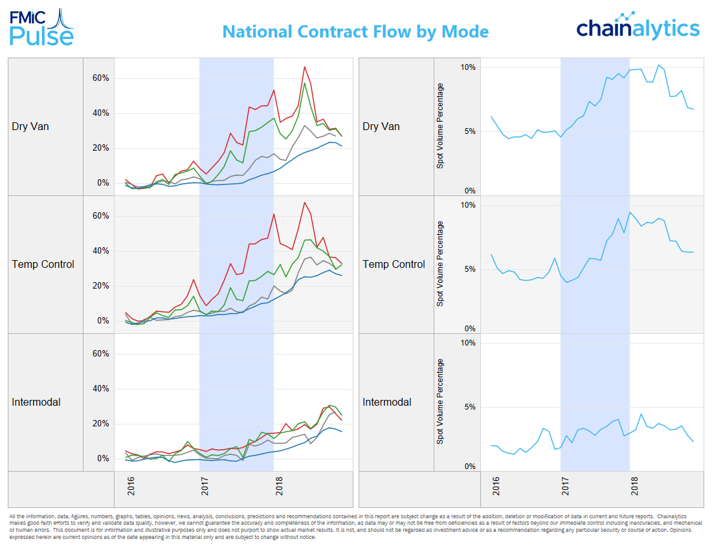
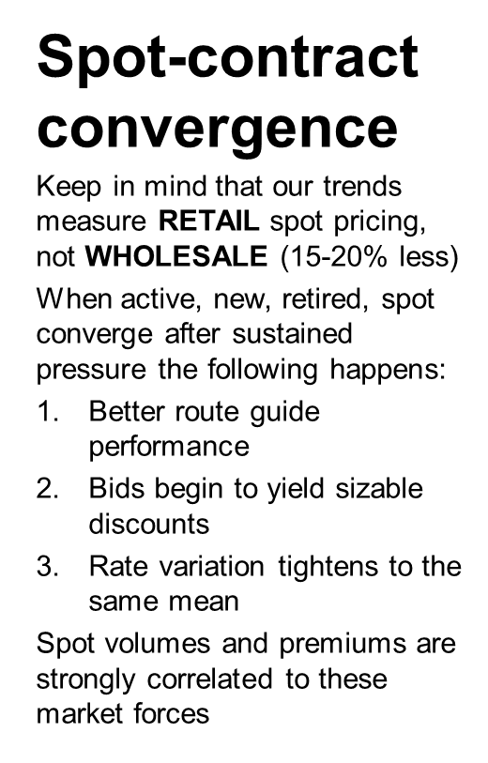

Slide 3
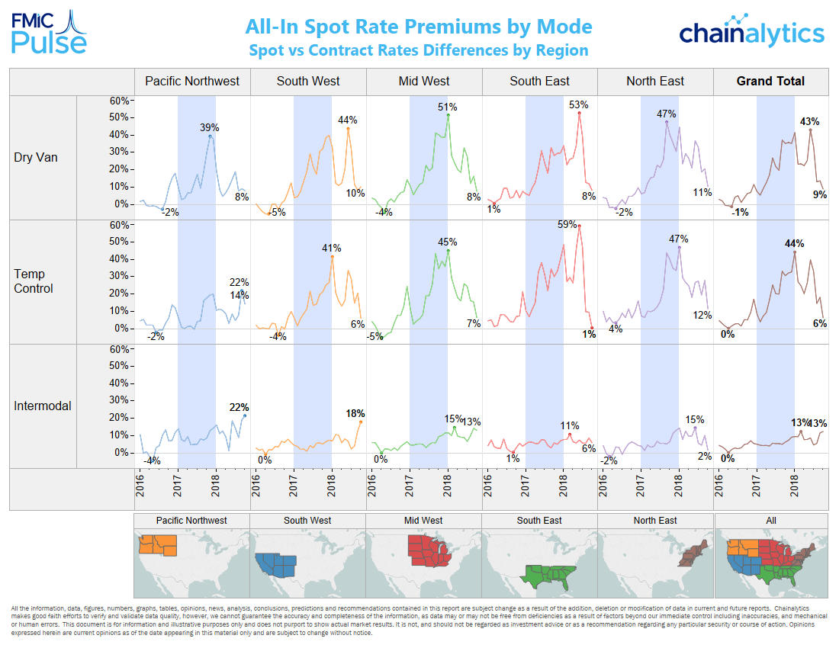
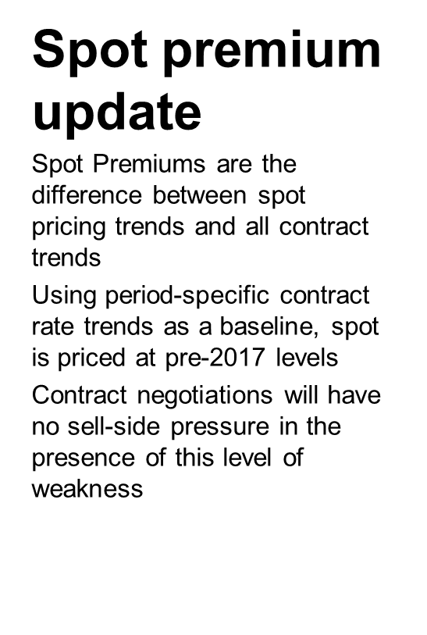

Slide 4
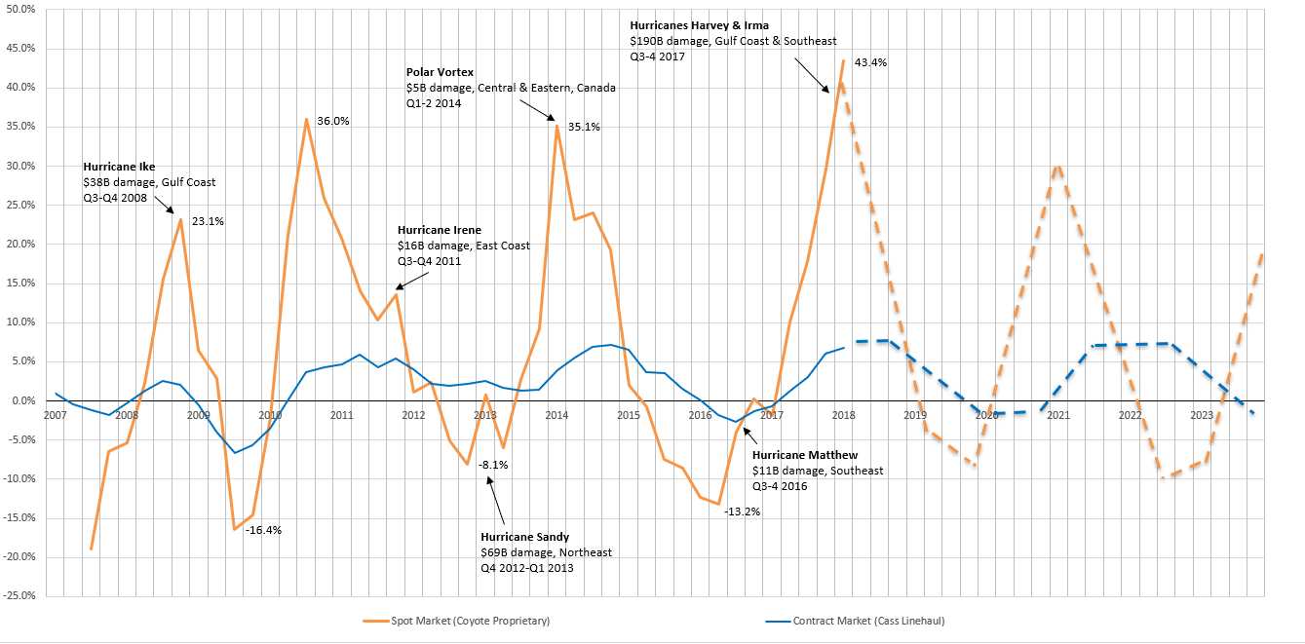
Navigating the US Truckload Capacity Cycle: Where are freight rates headed and why?
Journal of Supply Chain Management, Logistics, and Procurement | Vol 1, No.1, Summer 2018
https://www.henrystewartpublications.com/sites/default/files/Pickett.pdf
US TL Spot & Contract Market Pricing Index % Y/Y: Q3 2007-Q1 2018 Actuals & 2018-2023 Base Projections
Sources: Coyote Research, Cass Transportation Systems

Slide 5
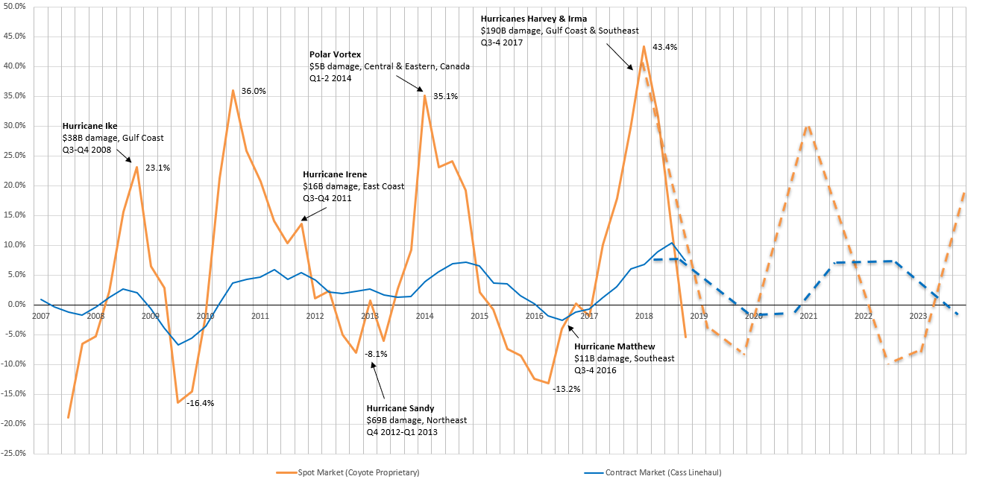
Navigating the US Truckload Capacity Cycle: Where are freight rates headed and why?
Journal of Supply Chain Management, Logistics, and Procurement | Vol 1, No.1, Summer 2018
https://www.henrystewartpublications.com/sites/default/files/Pickett.pdf
US TL Spot & Contract Market Pricing Index % Y/Y: Q3 2007-Q4 2018 Actuals & 2019-2023 Base Projections
Sources: Coyote Research, Cass Transportation Systems

Slide 6
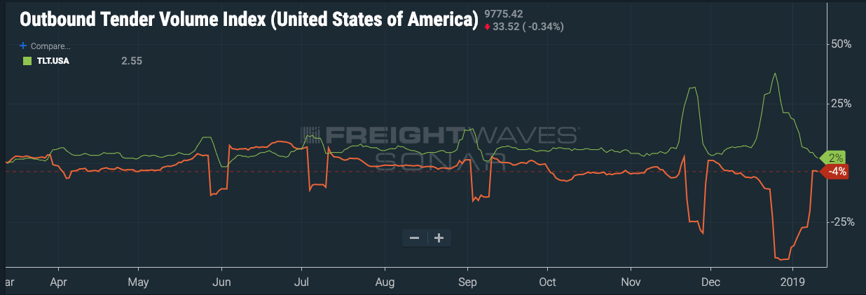

SONAR: near-time freight market analysis

Slide 7
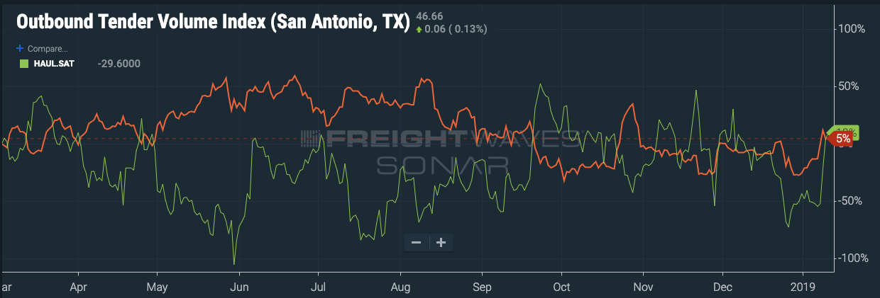
What’s happening today……

Slide 8

FTR forecast process
Detailed Economic Forecast
U.S. Tonnage Forecast
Commodity Analysis
Raw to Retail
Modal Share
Mode Specific Components
Vehicle/Car Type
Length of Haul
Average Load Size
Results

Slide 9
Active truck utilization
The longest known run at 100% utilization

