Slide 1
FourKites Predictive Visibility

Slide 2
What Does Predictive Visibility Do For You?
Provide better predictability to customers
Reduce operational costs
Reduce detention and fees
Improve Planning & Inventory Management

Slide 3
Improved Customer Service – Global Paper Company
Productivity Gains – C&S Wholesale Grocers
On-Time Delivery Improvement – Smithfield Foods
End-to-End ETA – Caterpillar

Slide 4
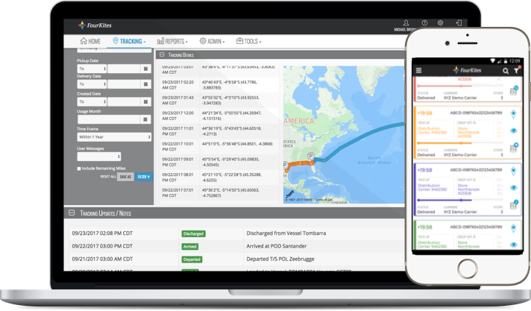
Solution Overview
TMS / ERP
Carrier / LSP
ELD / Mobile
TMS / ERP
Carrier / LSP
Railinc
TMS / ERP
Carrier / LSP
Status Events
AIS Vessel

Slide 5
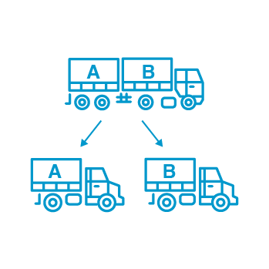
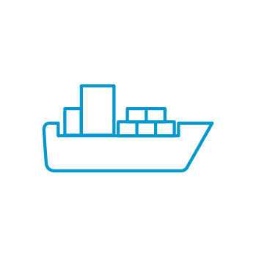
Industry-leading ETA through device integration & data science
FourKites delivers the most precise ETA’s in the industry. Here’s why:
FourKites has one of the largest databases of truck load data on the continent.
In addition to the widest network of GPS/ELD connections that ensure near real-time location updates, our algorithm has specific features that are designed to handle complex use cases, including:
GPS LOCATION DATA EVERY FIFTEEN MINUTES
TRUCK-SPECIFIC ROUTING WITH HERE MAPS
LOCATION-SPECIFIC OPERATING HOURS
PREDICTIVE LOAD AND UNLOAD TIMES
REAL-TIME TRAFFIC CONDITIONS, INCLUDING MAJOR INCIDENTS
WEATHER CONDITION UPDATES
REAL-TIME OCEAN TRACKING INFORMATION
REAL-TIME RAILTRACKING INFORMATION
PREDICTIVE TRAFFIC LANE-SPECIFIC PARAMETERS
PREDICTIVE DWELL TIME AT STOPS ACROSS MULTIPLE SHIPPERS
REAL-TIME PARCEL TRACKING INFORMATION

Slide 6
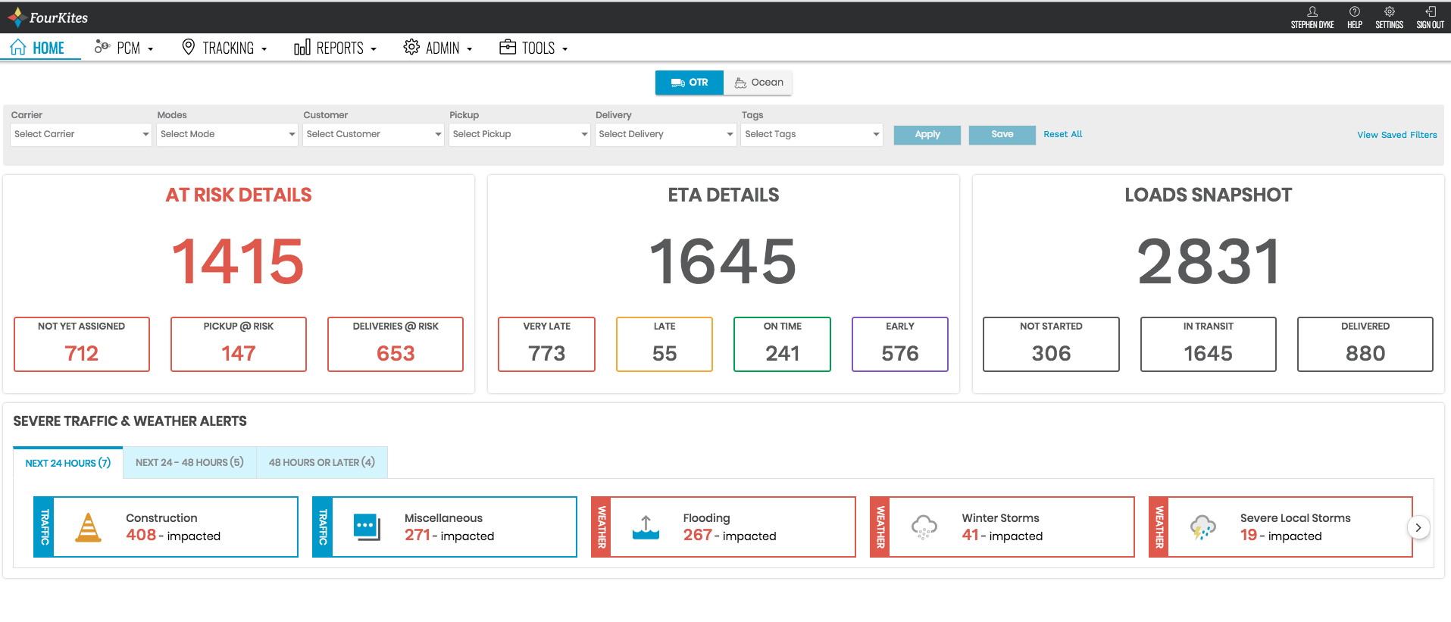
Landing Page Dashboard

Slide 7
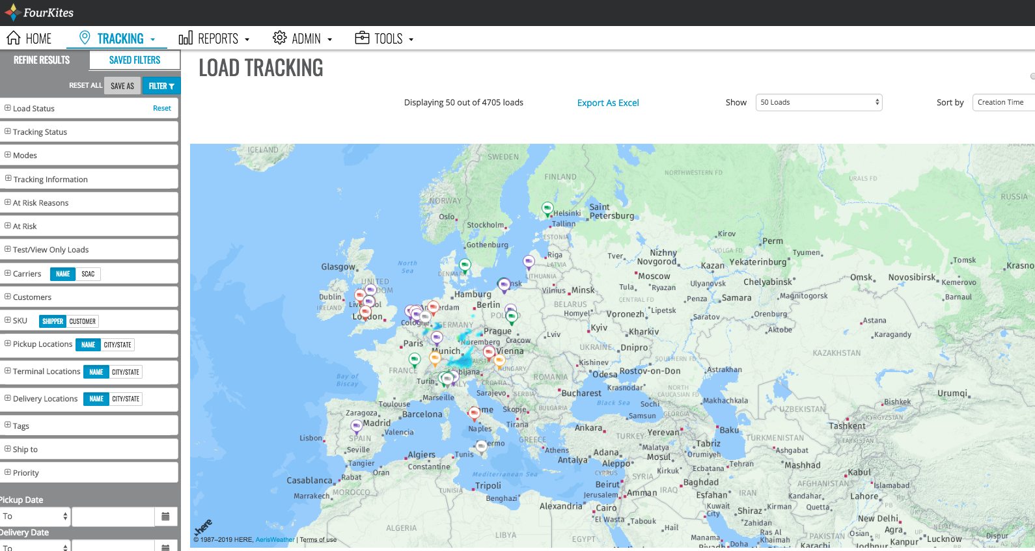
Advanced Filters & Alerts with integration to any TMS

Slide 8
THE COMPANIES WE SERVE
FourKites enables customers to lower their operating costs, improve on-time performance, and strengthen their end-customer relationships.
3PLS INCLUDE:
8

Slide 9
What is FourKites Predictive Capacity Management (PCM)?
What is PCM?
1
Private network
2
Predictive backhaul-load matching
3
Cross Fleet Optimization
Notes:
Three Key Principles:
Closed platform that…
…matches your underutilized dedicated fleet backhaul capacity with…
…your loads that otherwise would have been tendered to for-hire carriers

Slide 10
Why is PCM positioned for success?
Existing integrations between shipper TMS
Carriers already on-boarded to the platform
Seamless integration between TMS and dispatch systems
Predictive ETA and locations to forecast capacity
Dynamic matching begins once load information is received
Technology Network Foundation
Real-time Transportation
Data
Notes:
Calling back to the existing challenges of capacity management, this slide talks about why FourKites is uniquely positioned to overcome those challenges due to: the existing foundation of the platform and network, and the real-time data exchange.

Slide 11
Greg Colvin greg@fourkites.com 713-492-7930

