Slide 1
Sysco Inbound Supply Chain:
Predictive Visibility Platform
Terry Finnegan, Sr. Director
Market Logistics Management
January 2019

Slide 7
So why a visibility tool?

Slide 8
Benefits of improved service span the organization
Operations can manage receiving more efficiently
Enables Merchandising & Sales to proactively manage customer expectations
Consistent On Time Service can allow flexibility in Safety Stock Levels
Live dwell time tracking & reduction supports carrier rate favorability

Slide 9
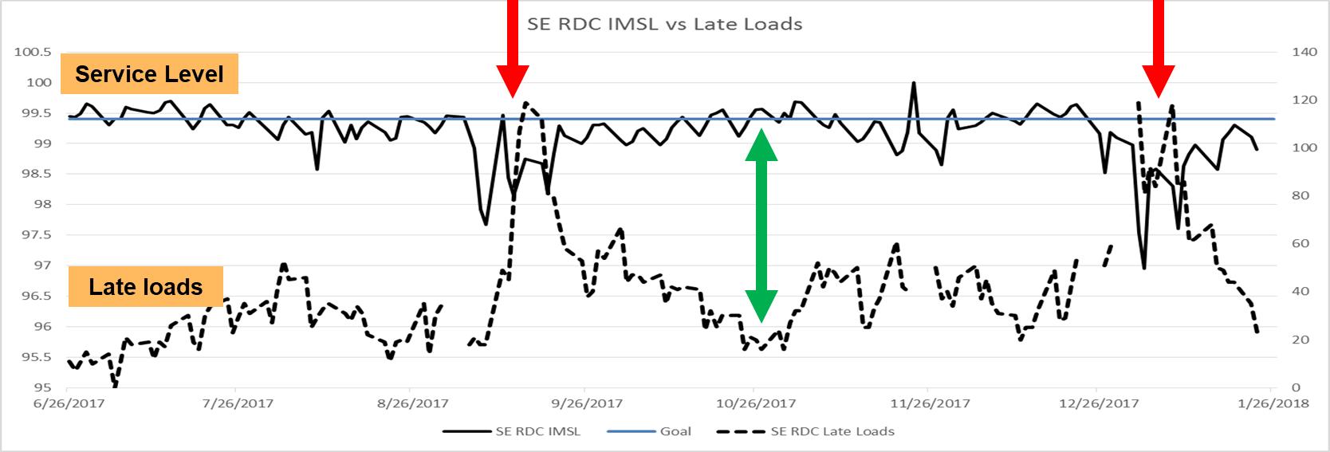
Why is this important and what value will be gained?
z
Our VISION
Improving inbound service directly affects our customers’ experience
To be our customers’ most valued and trusted business partner

Slide 10
Sysco’s Visibility Journey
Sysco’s Visibility Journey
Why FourKites?
Key Benefits and Next Steps..

